Slide 1
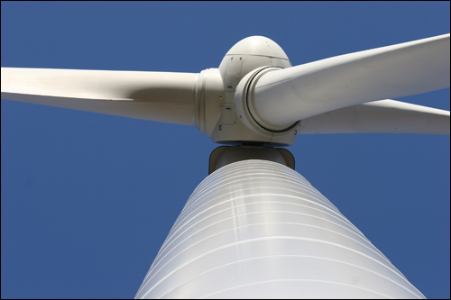
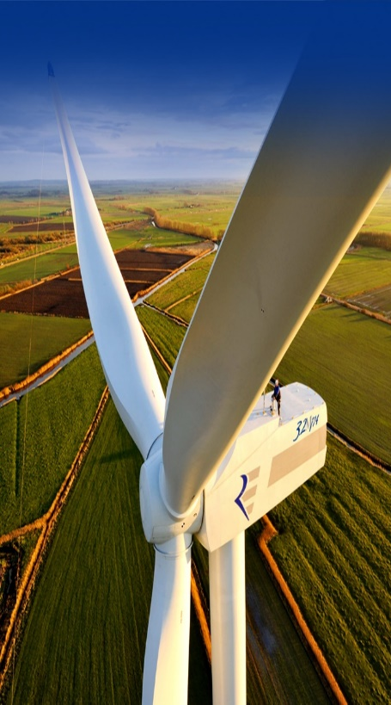
Same turbines, different perceptions – how networks, norms and trust influence wind turbine acceptance. A case study of the wind turbine planning in Lemvig Municipality
Tine Reimer
Cand.scient. Nature Management

Slide 2
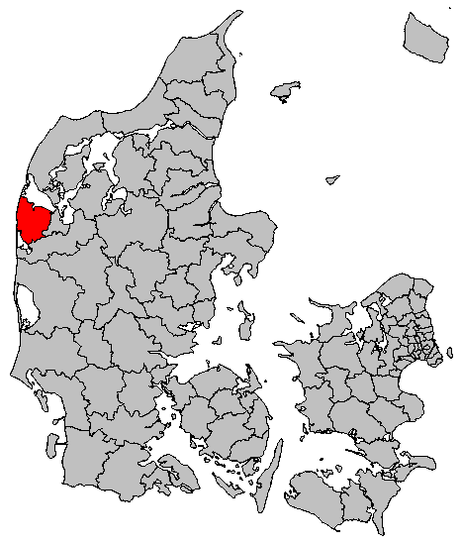
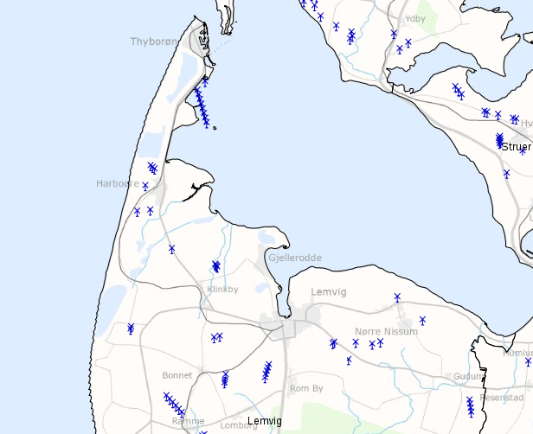
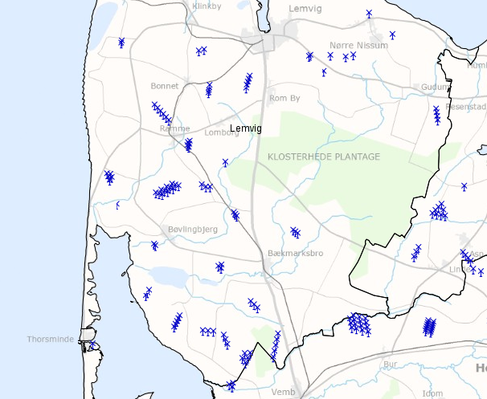
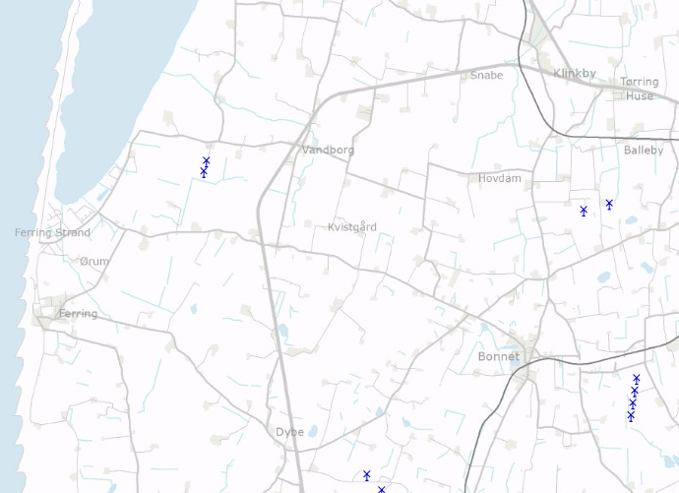
Lemvig Municipality

Slide 3
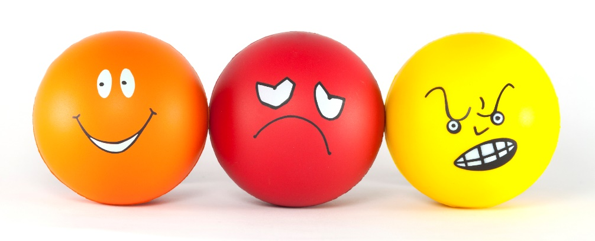
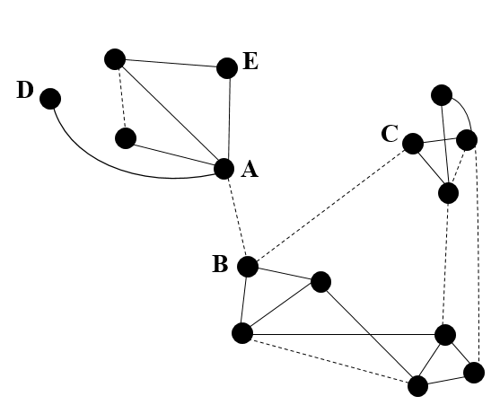
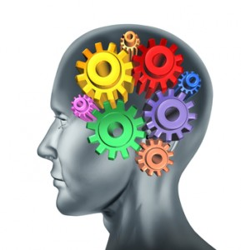
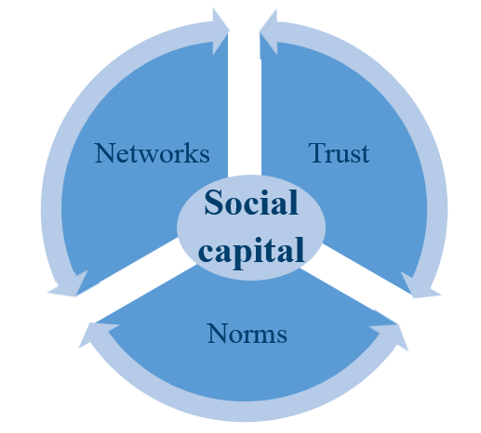
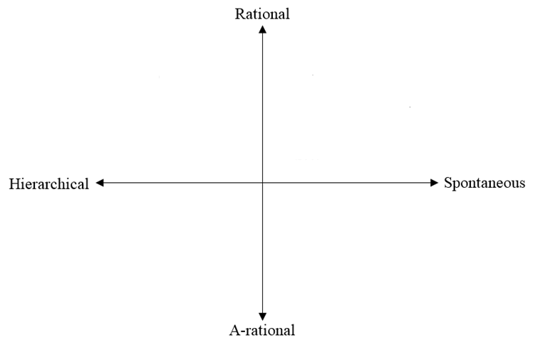
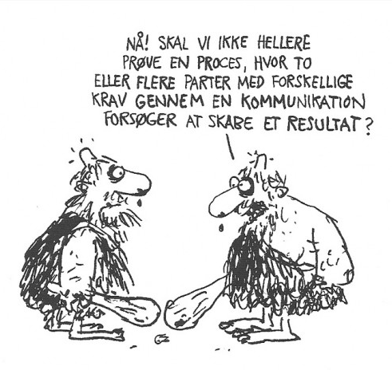
Social Capital
§
Cognitive vs Emotional trust
Trustworthiness
Personal, general and institutional trust
Incest taboo
Notes:
http://www.pinterest.com/snsdfans/strange-animals/
http://elliottanalysis.com/2013/05/16/gold-investment-advice-how-to-select-the-gold-dealer/
http://www.druckerinstitute.com/2011/06/you-say-you-want-an-institution/
https://judythewriter.wordpress.com/2013/09/09/dates-trigger-emotions-so-should-your-writing-5-ways-to-write-for-emotional-impact/
http://undergroundhealthreporter.com/cognitive-abilities/
http://en.paperblog.com/trust-or-trustworthiness-thinkibility-nibble-663055/

Slide 4
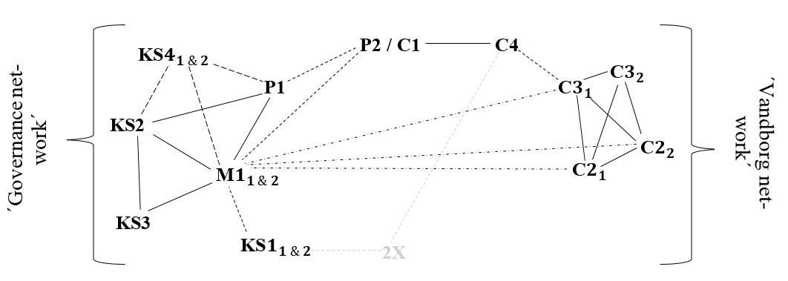
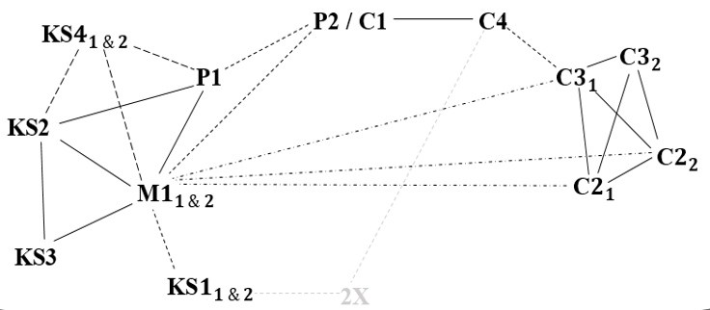
The structural hole in Lemvig’s wind turbine network

Slide 5
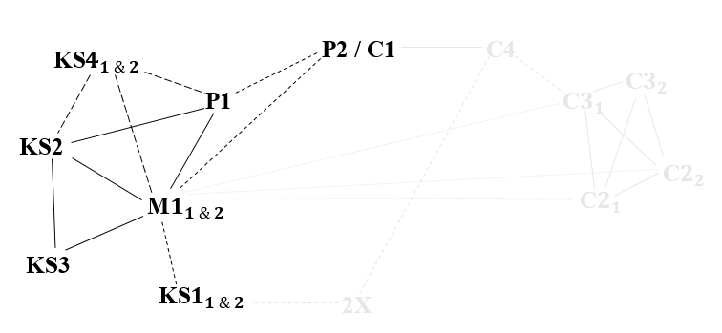
The ‘old’ planning process; why so successful?
Cognitive trust
Institutional trust
Political bravery
Social capital
Theme plan
Democratic participatory planning norm
Landscape norm
Local plan
Rule norm
Economic gain norm
Community gain norm

Slide 6
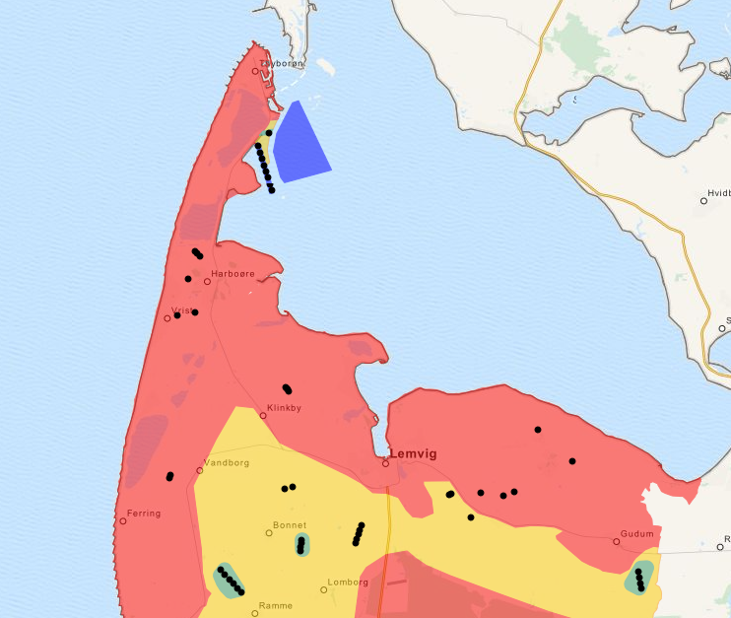
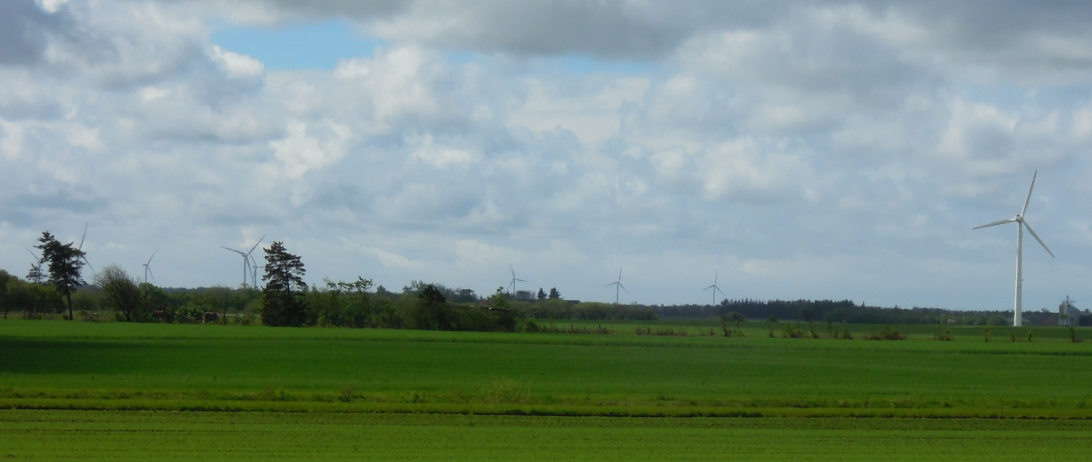
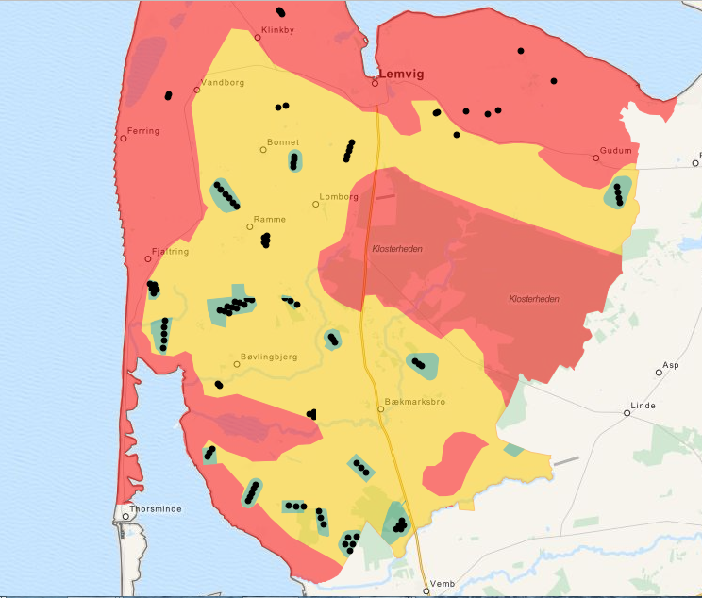
The ‘new’ planning process
Saturation point– local support norm
Wind is for everyone– expanded economic gain norm

Slide 7
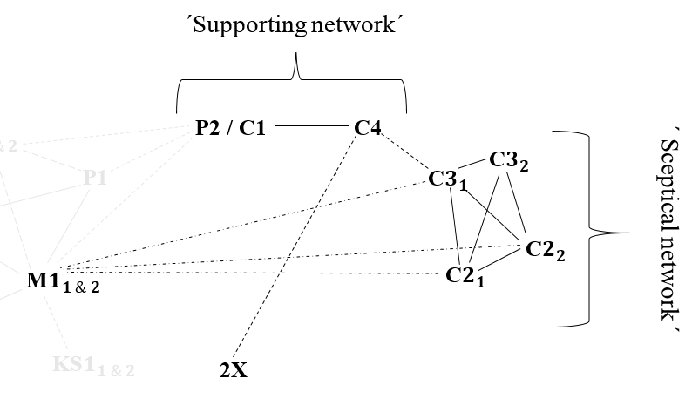
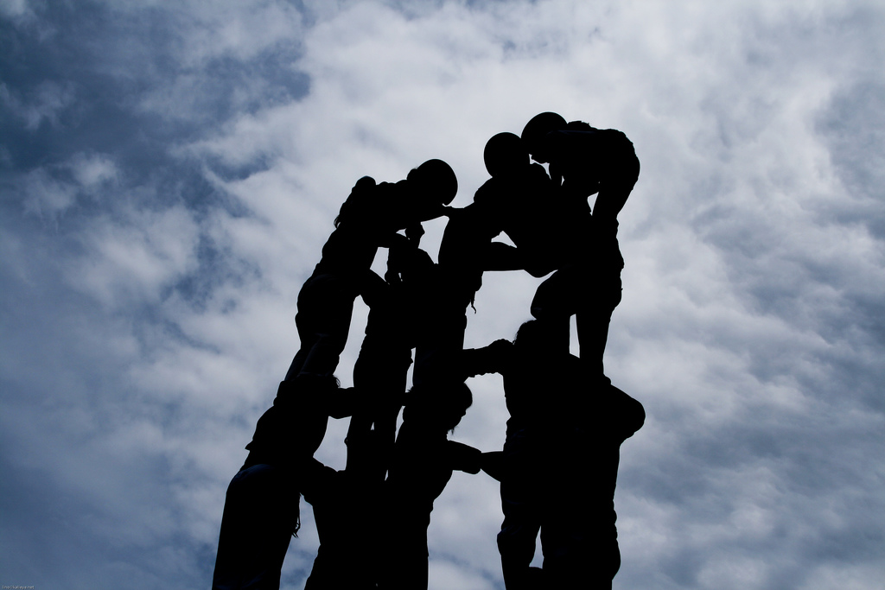
Vandborg; what caused the problem?
Emotional and cognitive (miss) trust
Trustworthiness
Institutional trust
Social kapital
Inclusive participatory planning norm
Inclusion norm
Allocation norm
Expanded economic gain norm
Community gain norm
Local support norm

Slide 8
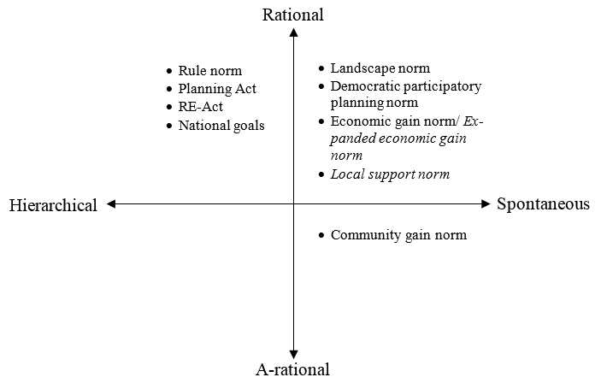
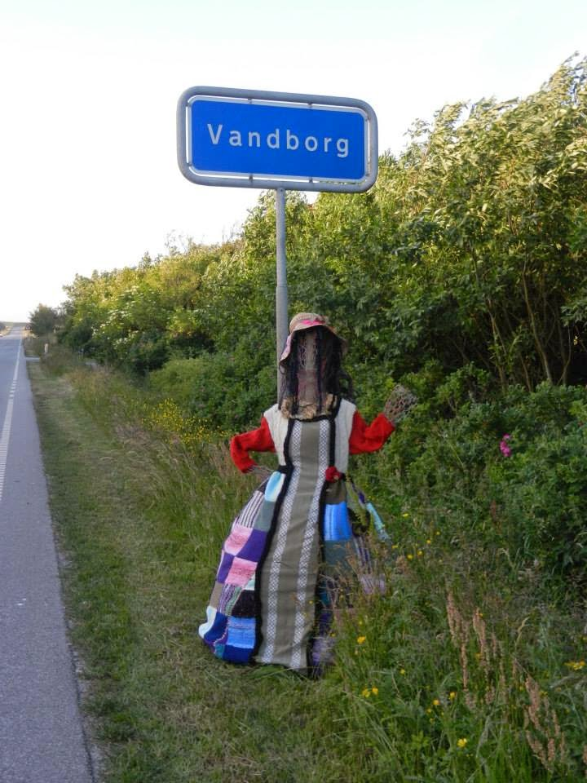
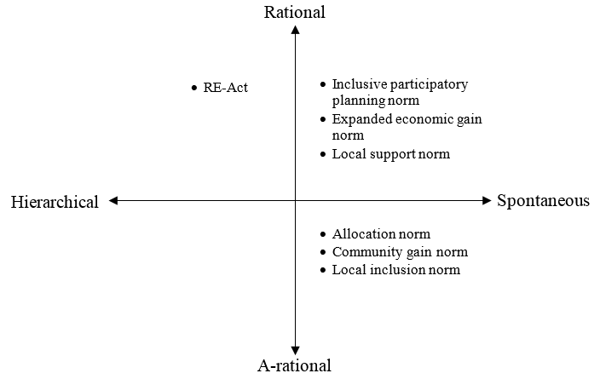
The planning challenges
‘Governance network’
Cognitive
vs
Emotional
Structural hole
‘Vandborg network’

Slide 9
How to meet the scepticism
Gain a common language
Involve citizens by spanning the structural holes
Define process and outcome before allocating
Validate the opposition
”Ja, men det er nemt at være modstander, ikke. Du behøver ikke at komme med løsninger, du kan bare komme med angreb. Så er det op til os, at komme med løsningsforslag.” (C4)
“Yes, but it is easy to oppose, right. You don’t need to come up with solutions, you can just attack. And then it’s up to us to propose the solutions” (C4, translated by Tine)
Notes:
http://www.fefo.no/no/Naturressurser/Sider/Vindkraft.aspx

Slide 10
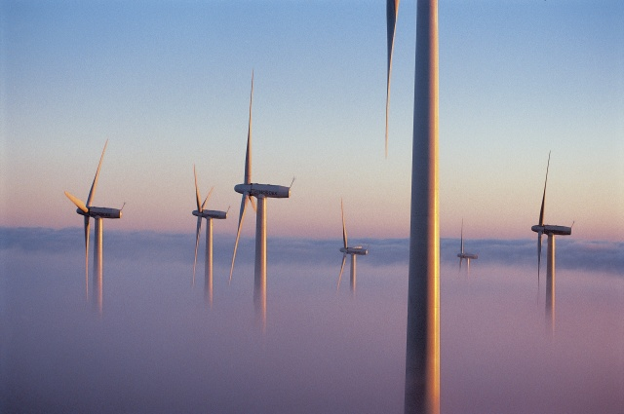
Thank you

