Slide 1
Promotion of Renewable Energy act
Wind2050 project meeting – January 29, 2015
- Energinet.dk, Henrik Kamp Justesen

Slide 2
Promotion of Renewable energy
Price supplement for wind turbines (and other electricity production plants which use renewable energy sources)
Measures to promote the expansion of wind turbines
Access to exploiting energy from water and wind offshore
Connection of and safety requirements for wind turbines
Regulation of electricity production from offshore wind turbines subject to a tendering procedure

Slide 3
The Four schemes
Introduced in 2009
- Aims at promoting acceptance of and involvement in the development of onshore wind power…
A loss of value scheme
An option to purchase scheme
A green scheme
A guarantee scheme

Slide 4
Total of turbine projects

Slide 5
The loss of valuation scheme

Slide 6
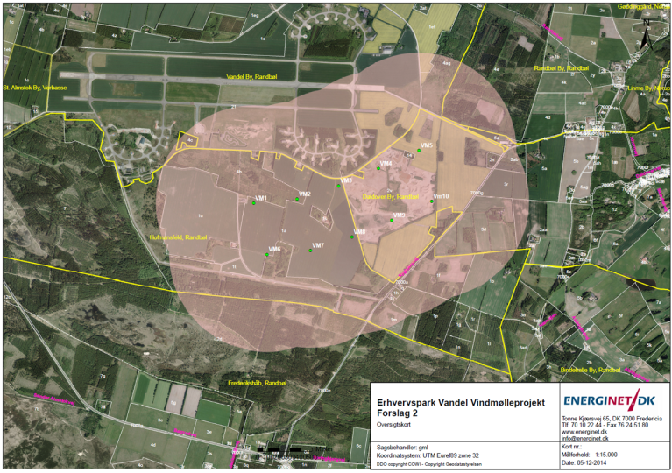
Loss of value scheme
914 decisions for compensations
About 56 % is granted compensation
Average compensation on properties DKK 127.000 (81.500)
Notes:
The loss of value scheme - ensures that property owners who become neighbors to wind turbines can be compensated for loss of value on their property. The scheme complements the ordinary neighboring law and constitutes a special field of environmental law. According to the Renewable Energy Act (VE-loven) the scheme shall support the promotion of renewable energy in Denmark.

Slide 7
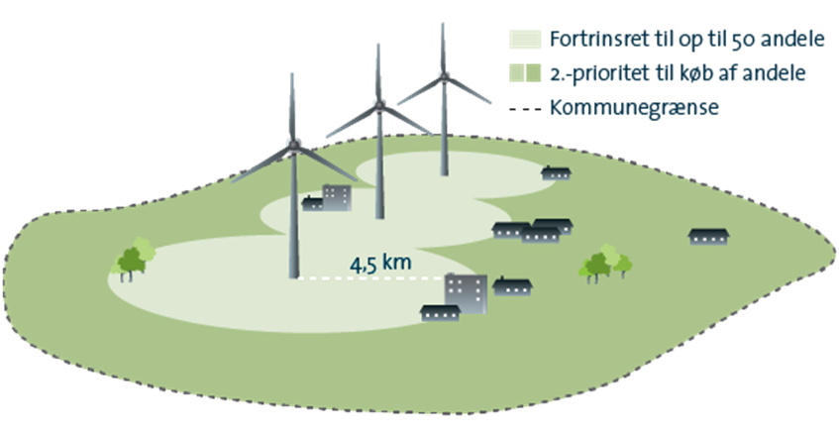
The option to purchase scheme

Slide 8
The green scheme

Slide 9
The guarantee scheme

