Slide 1
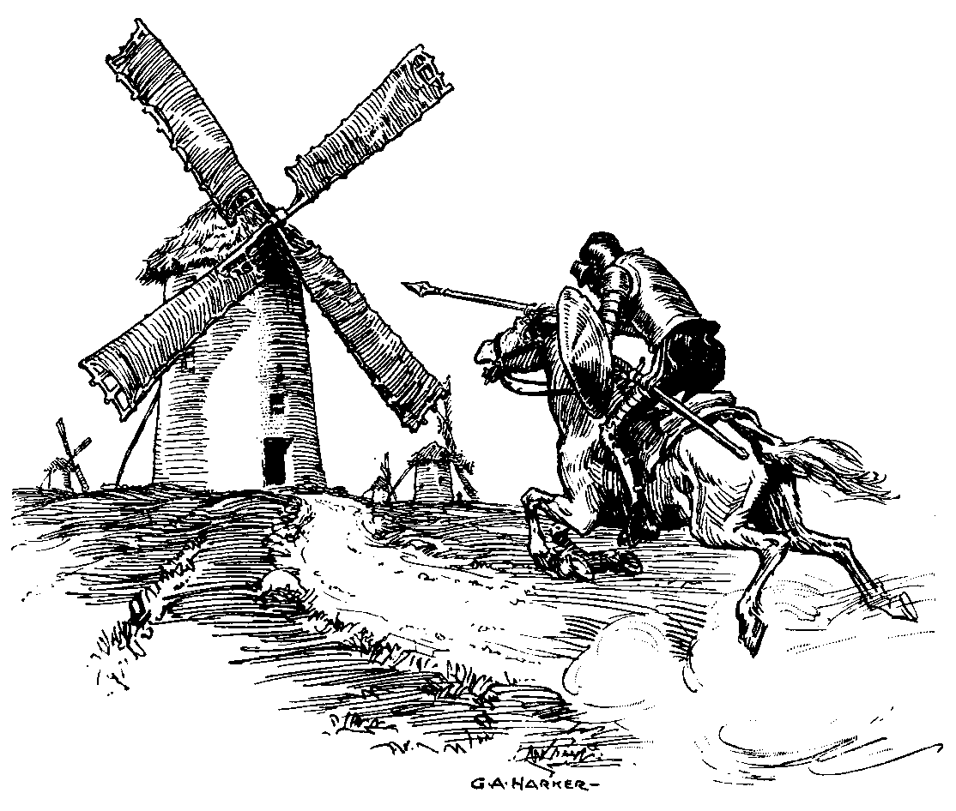
The Vindication of Don Quijote: The impact of noise and visual pollution from wind turbines
Cathrine Ulla Jensen, IFRO
Thomas Hedemark Lundhede, IFRO
Toke Emil Panduro, IFRO

Slide 2
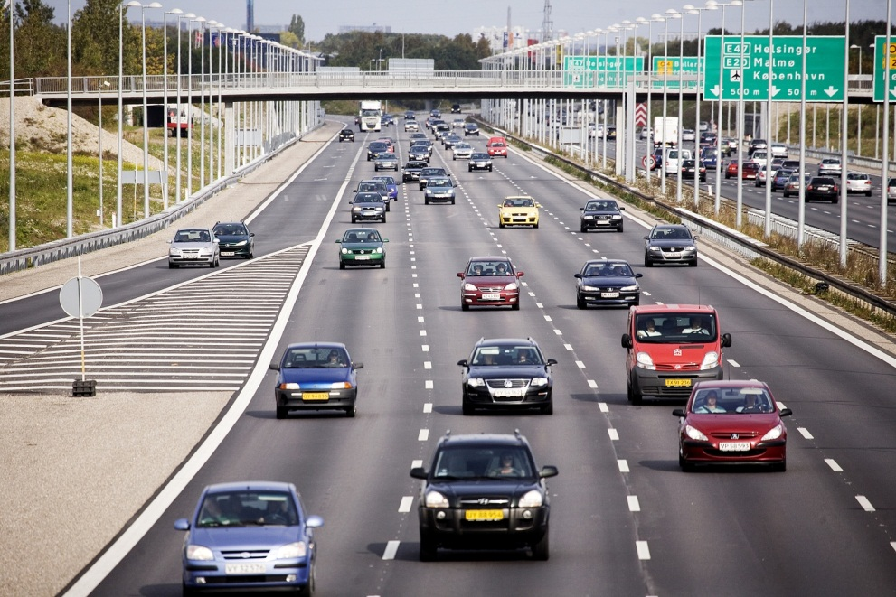
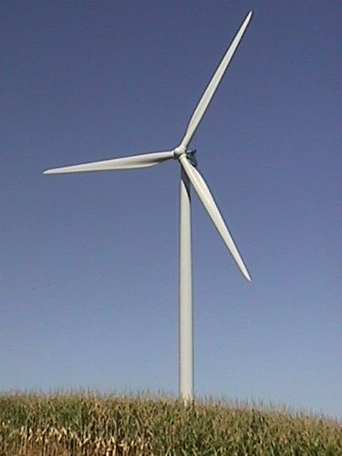
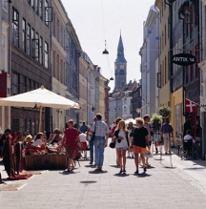
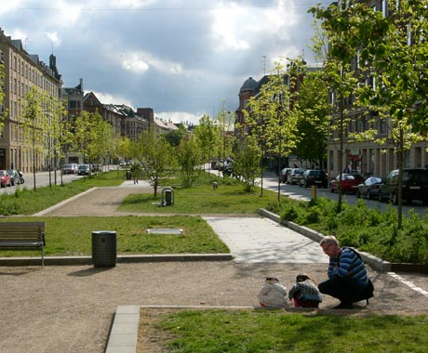
Some of the things we have worked on
A lot of experince with hedonic house price modelling
Several projects with the Ministry of Environment “Byliv, der betaler sig”
The Danish Economic Counsels - noise and green space
Published and article to be published
Working on spatial sorting models
Urban characteristics
Cost of
windturbines
Climate adaptation
The value of parks

Slide 3
Literature
Stated preference studies – choice experiments
Positive towards windpower
(Borchers, Duke, & Parsons, 2007)
Noise and visual pullution
(Ladenburg, 2009; Ladenburg & Möller, 2011; Meyerhoff, Ohl, & Hartje, 2010)
Few hedonic studies
(Heintzelman & Tuttle, 2012; Hoen, Wiser, Cappers, Thayer, & Sethi, 2011; Sally Sims & Dent, 2007; Sally Sims, Dent, & Oskrochi, 2008)
Too few observations, too little variation
Only straight line calculations

Slide 4
The House Price Function
Properties are heterogeneous goods
Structural (S), Neighborhood & Environment (Q)
Assumptions:
The house price is generated from a marked in equilibrium
Households utility maximize
House price variables are continues and independent of other house price variables
The implicit prices from the house price function reflect the value households obtain by consuming each house characteristic

Slide 5
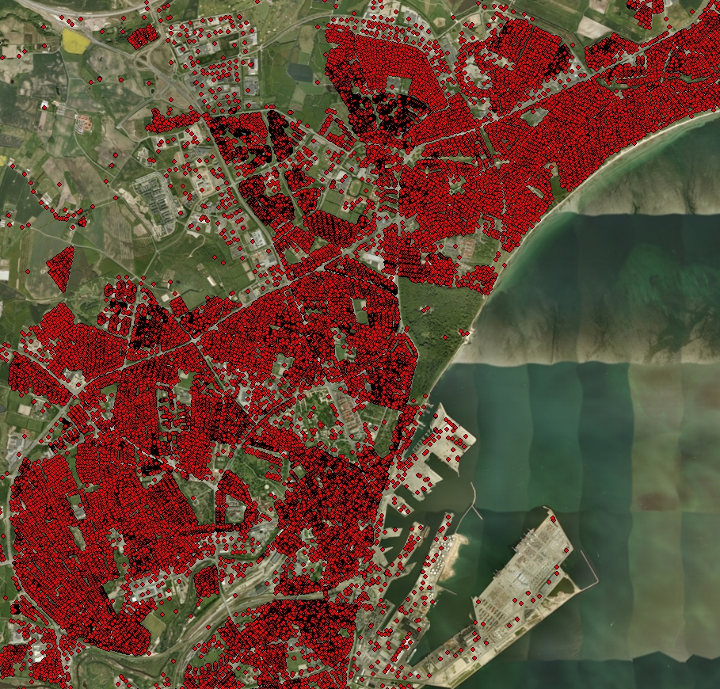
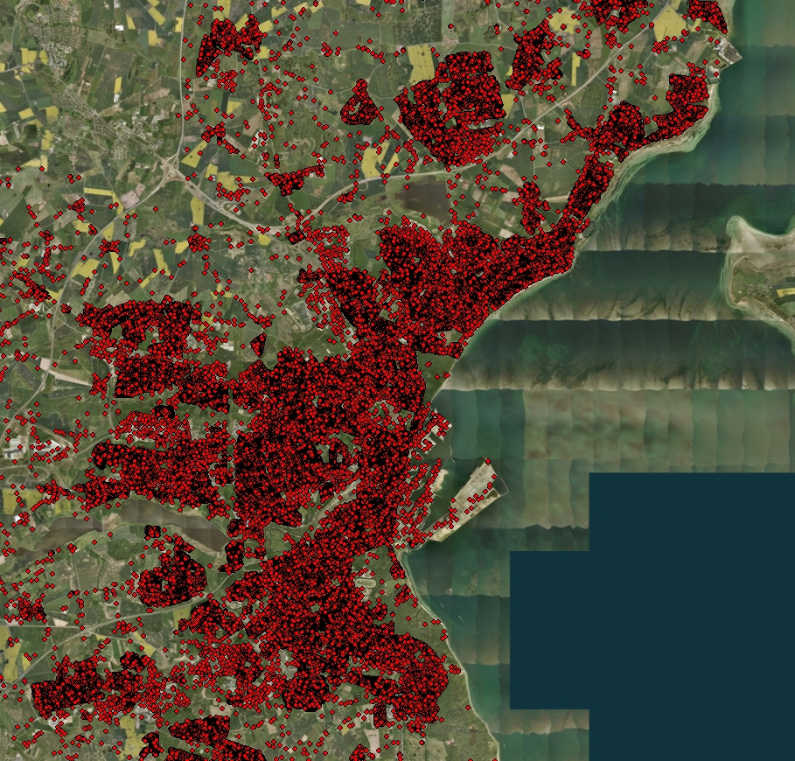
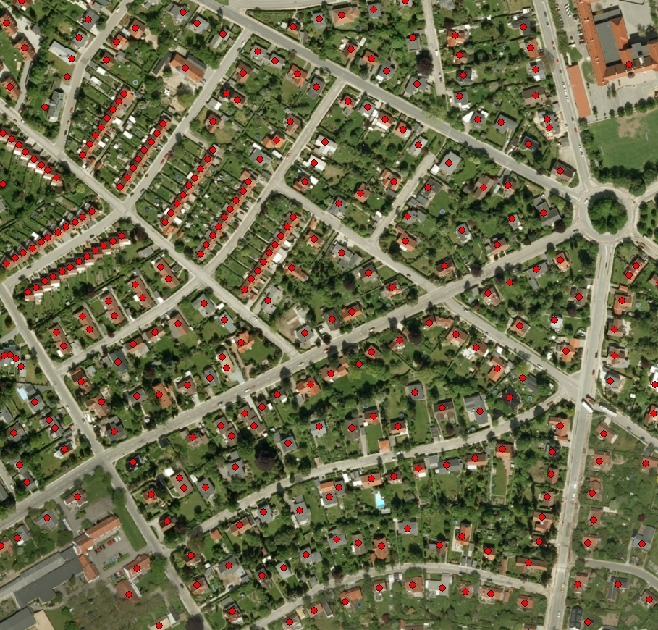
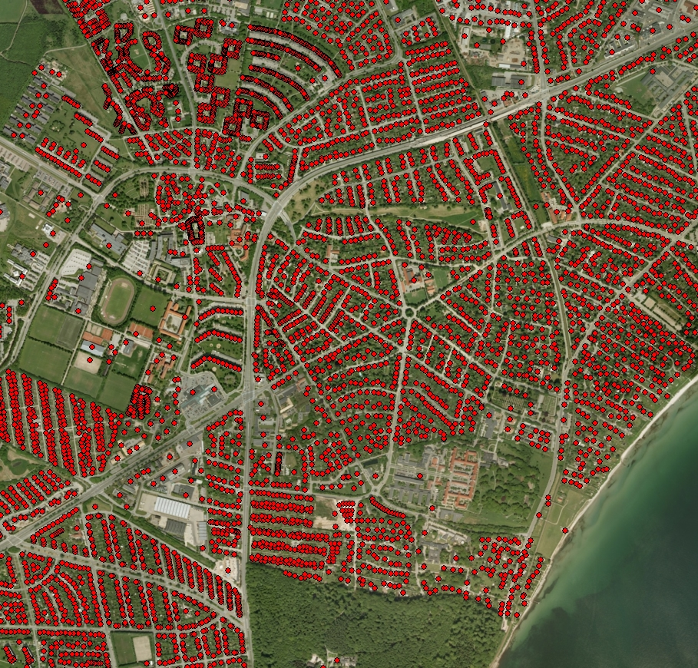
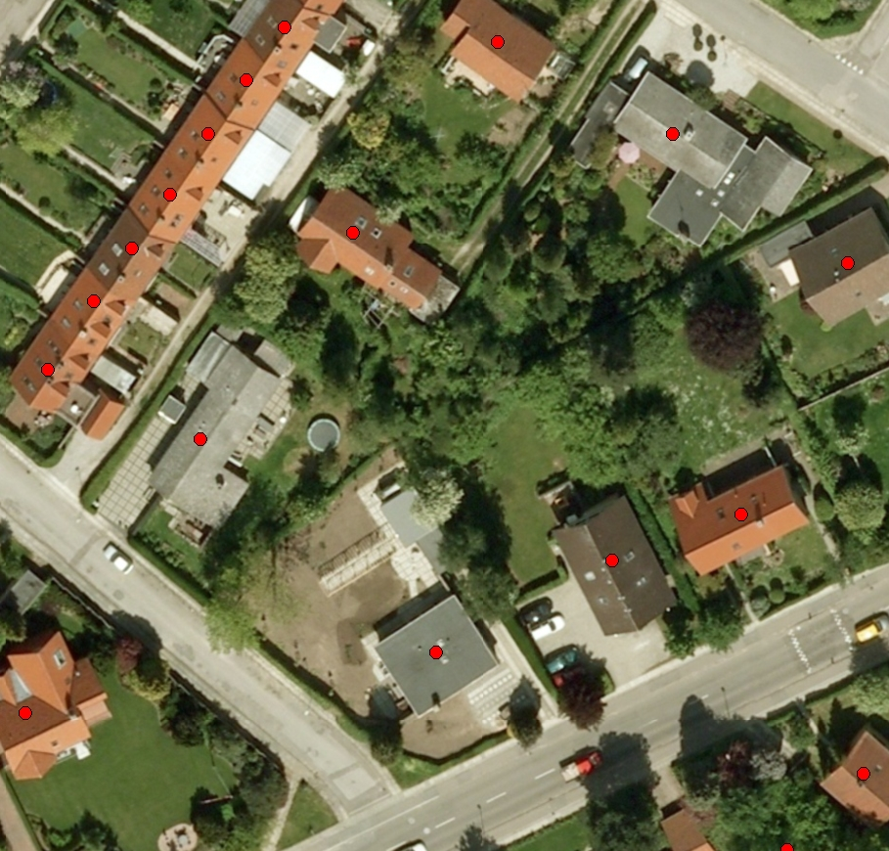
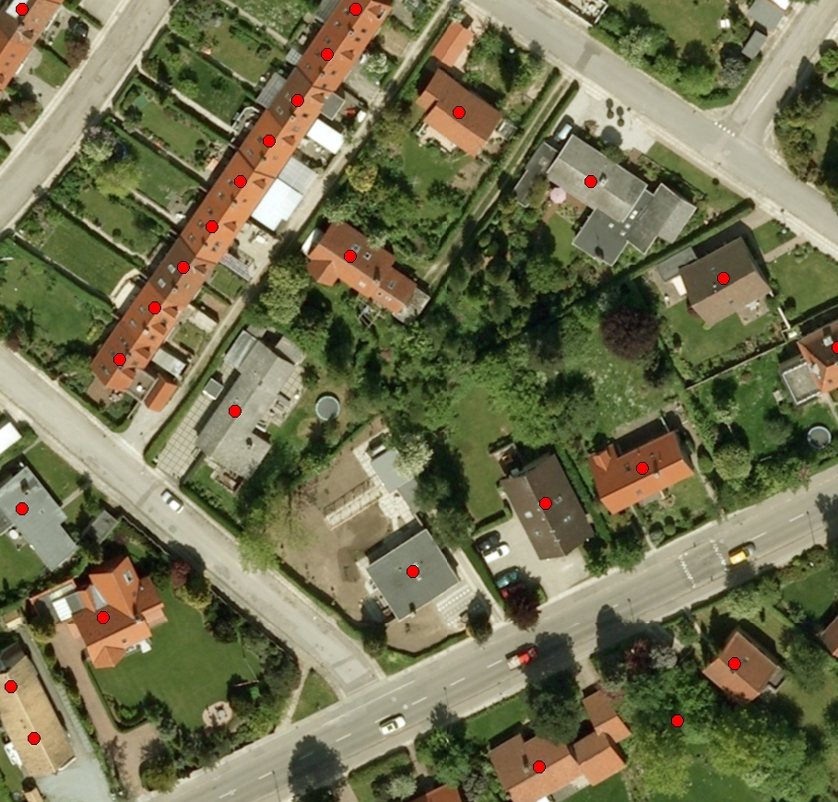
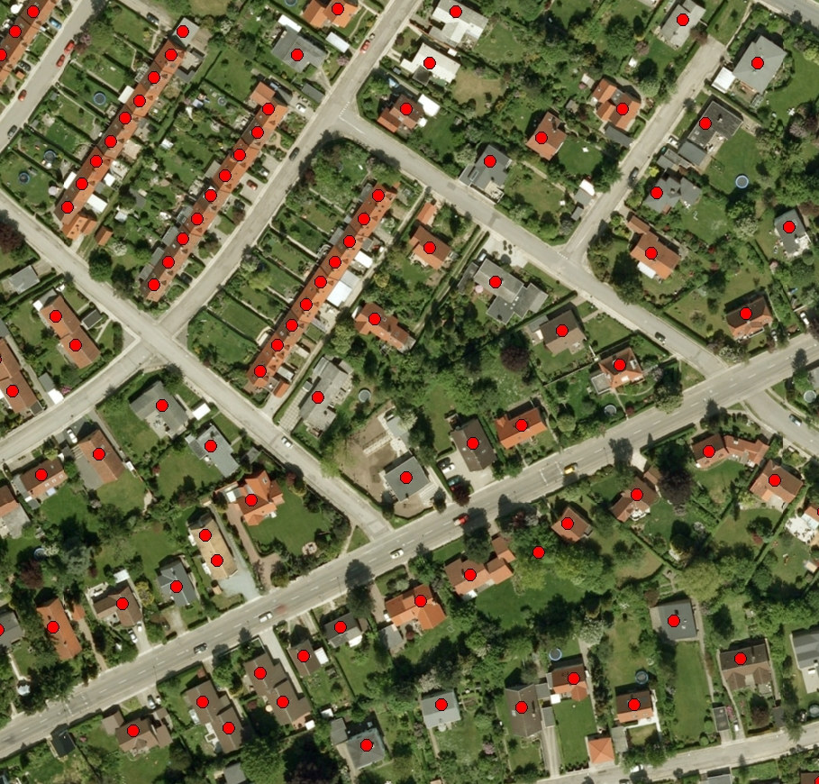
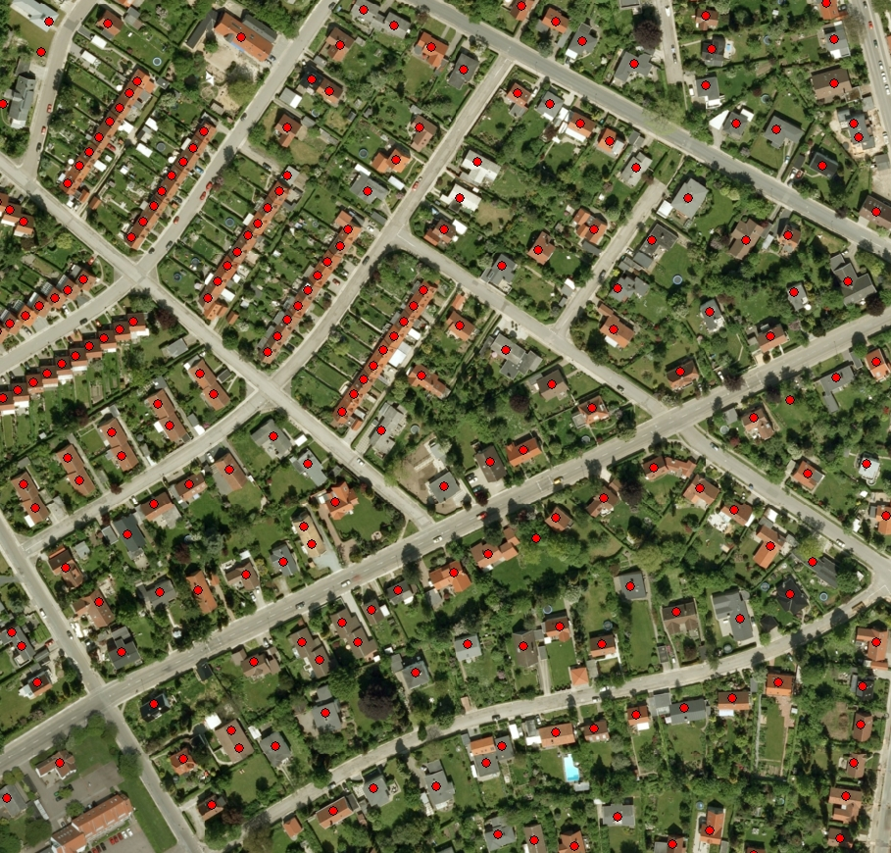
Data
Sales prices
Construction variables
Neighborhood variables
Environmental variables
Socio-economic data –
It is possible.
Value of externality

Slide 6
Suvey area
24 spatially detached sub-survey areas
Each sub survey area are 2,500 meter in radius
647 km²
20 municipalities
55,864 houses
Selection criteria:
As many transactions as possible within 600 meter

Slide 7
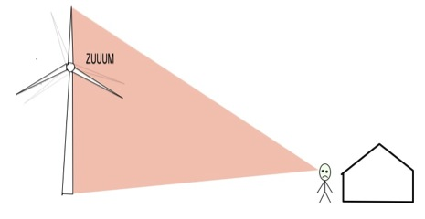
Visual pollution
The area appear more developed and less rural or less authentic
Degraded a scenic view.
Movement in the landscape
Less tranquility and peacefulness
Flickers of light shadow-flicker
Viewshed based on DSM

Slide 8
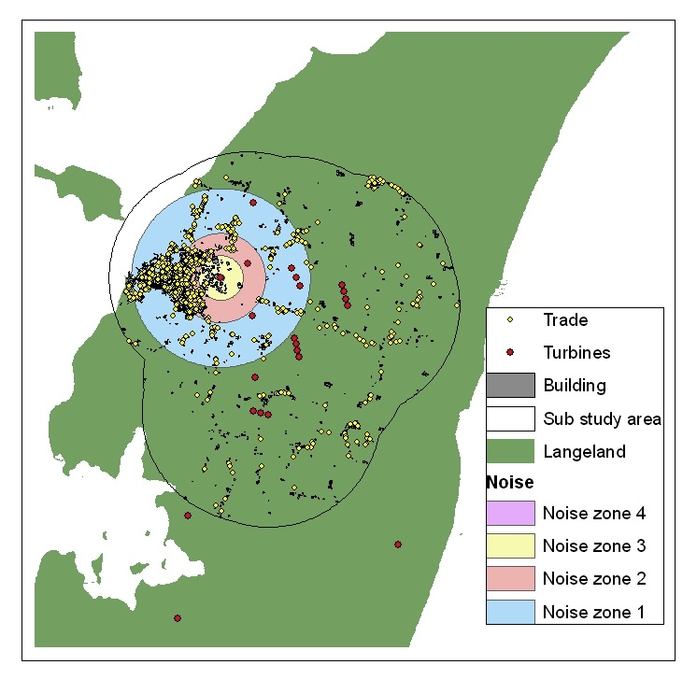
Noise pollution
Source
wings cut through the air
mechanics of the turbine
Tonal and low frequency
Calculated in dB
bekendtgørelse om støj fra vindmøller
< 20 dB, 20-29 dB, 30-39 dB, 40-50 dB

Slide 9
Hedonic model in two steps
The cross-pooled model
Correct for difference in price over municipalities over time
Spatial econometric model

Slide 10
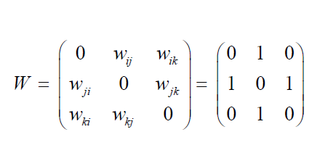
Spatial autocorrelation - spatial correlation in the error term
• Mis-measurement of spatial variables
• Misspecification of variables
• Omitted spatial variables
The spatial weight matrix define the outline of the unknown spatial processes.

Slide 11
Challenges - spatial econometric model
Defining the omitted spatial processes in the spatial weight matrix
Data generating process
The total, indirect and direct
You have a benefit of my additional bathroom
Equilibrium model with a ripple effect
Assumption: The error term is not correlated with the other repressor's

Slide 12
Results
Variable | OLS |  | SEM |  | SARAR
View | -0.1168 (0.0134) | *** | -0.0315 (0.0172) | . | -0.0398 (0.0154) | **
View*distance | 6.99E-05 (8.42E-06) | *** | 2.42E-05 (1.00E-05) | * | 2.78-05 (1.00E-06) | **
20-29dB | -0.0368 (0.0059) | *** | -0.030 (0.0102) | 7** | -0.0256 (0.0080) | **
30-39dB | -0.0512 (0.0118) | *** | -0.0550 (0.0190) | ** | -0.0442 (0.0151) | **
40-50dB | -0.0433 (0.0243) | . | -0.0669 (0.0273) | * | -0.0509 (0.0243) | *
λ – error term |  |  | 0.6004 (0.0120) | *** | 0,4413 (0,0254) | ***
ρ – lag term |  |  |  |  | 0.2678 (0.0276) | ***

Slide 13
Interpretation
Parameter | % of the house price | Average MWTP (EUR)
View (dummy) | -3.15 % | -6,233
View*distance (per 100 meter) | 0.242% | 479
20-29 dB (dummy) | -3.07% | -6,075
30-39 dB (dummy) | -5.50 % | -10,883
40-50 dB (dummy) | -6.69% | -13,239
800 metes - prices drop between 10.32% and 13.94%.

Slide 14
Conclusion
Noise and visual pollution have a considerable impact on surrounding properties
We are able to quantify these impacts
Estimates could be used in compensation schemes
Things to do:
Before after analysis
Accumulation effect
A second stage analysis
Optimal location analysis

Slide 15
Thank you for your attention
Toke Emil Panduro
Msc, PhD, Postdoc
Spatial Environmental Economics
Department of Food and Resource Economics
Faculty of Sciences, University of Copenhagen
Rolighedsvej 23, DK-1958 Frederiksberg C
Mobil 23962908
Mail tepp@ifro.ku.dk
http://sites.google.com/site/tokeemilpanduro/

