Slide 1
Generation vs. Social Cost
Effects on Wind Turbine Siting Decisions
Pablo Hevia-Koch
phev@dtu.dk

Slide 2
Context: Nearshore auctions in DK
Closer = Cheaper?

Slide 3
Context: Nearshore auctions in DK
Recent tenders in Offshore Wind in DK
5 new sites for Nearshore Wind Farms (~350 MW)
Nearshore sites potential is limited (vs offshore)
Nearshore has higher social acceptance than onshore
Motivation: Sites closer to the shore are cheaper (?)

Slide 4
Cost Curves: Nearshore advantage?

Slide 5
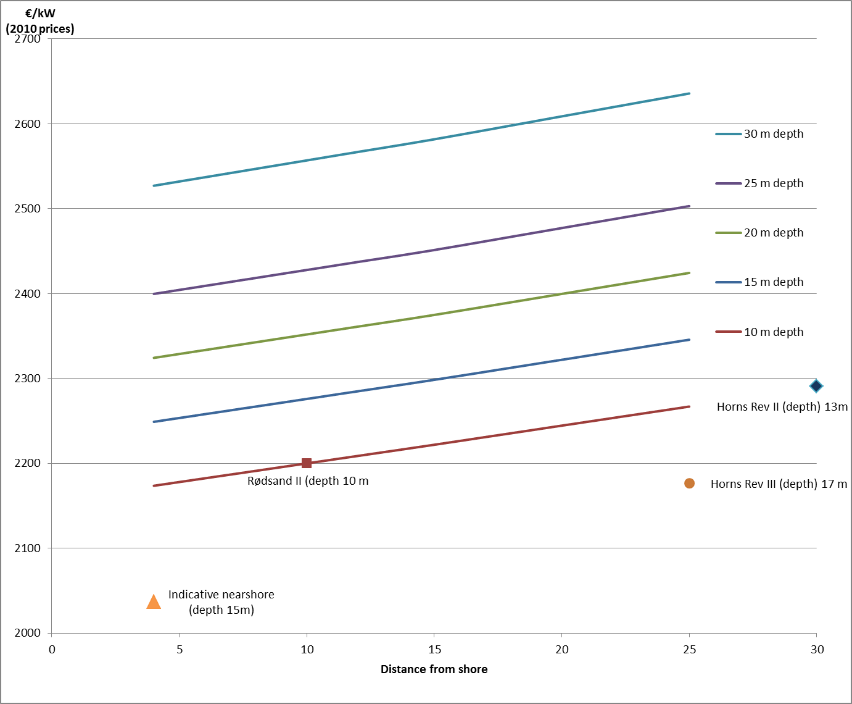
Recap on Cost Curves

Slide 6
Recap on Cost Curves
Main driver for cost is water depth
Distance to shore has a smaller impact
Reference potential cost reduction from pure distance reduction is limited (4-6% from 25 to 5 km)
Benefits might exist from increased competition

Slide 7
Preferences: WTP vs Distances

Slide 8
Preferences for Nearshore
Ladenburg et al. 2011:
Reference scenario 3600 MW wind expansion
Choice experiment
Six choice sets
Visual disamenities reduction
Reference of 8 km.
Possible reduction to 12, 18 or 50 km

Slide 9
Preferences for Nearshore
Ladenburg et al. 2011:
Study design and attribute levels validated via focus group
WTP extracted through fixed increases to annual electricity bill
WTP per household (ref. is 8 km):
12km: 153 kr/year
18km: 63 kr/year
50km: 233 kr/year

Slide 10
Marginal WTP

Slide 11
Marginal WTP
Decreasing Marginal WTP
Sharp drop for distances > 12 km
Limited decrease in WTP beyond 18 km

Slide 12
The Question:
Does the Willingness-to-Pay due to visual disamenities compare to the possible cost reductions from siting wind turbine farms closer to the shore?

Slide 13
WTP Aggregation
Considering a “back of the envelope” (naïve) aggregation:
2480879 Households in DK
Values in €
Marginal WTP per km (€/kw per km)
20 years life time

Slide 16
WTP Comparison
Changes in distance to shore while maintaining water depth constant present very limited cost reduction opportunities
When looking at constant depth cost reductions opportunities, they are at the same level as marginal WTP.
Changes in water depth present much higher cost reductions, comparably above estimated WTP values for most distances. (Very low distances data is not accurate)

Slide 17
Discussion Points
This is not a perfect measure of the optimal siting distance!
Definitely opens the discussion regarding the effectiveness of cost savings by minimising distance to shore
Water depth and distance to coast are often correlated. (Not denying that)
Other possible advantages of nearshore (e.g. increased competition) might help break the parity.
For now, we cannot assume that just minimising distance to coast will result in cheaper wind farms. (ceteris paribus)

Slide 18
Thank you
Questions?

